Slide 1
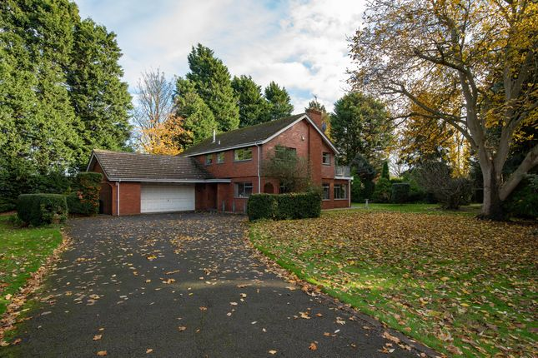
BOSTON HOUSE PRICE ANALYSIS
BY UTTAM KUMAR

Slide 2
INTRODUCTION :
House price increase every year, so there is a need for a system to predict house price in the future.
Here I have taken Boston House Price Dataset to perform Exploratory Data Analysis and Machine Learning.

Slide 3
DATASET INFORMATION
Boston House Price Dataset was collected in 1987 and has 506 entries with 14 attributes.
Boston House Price Dataset Attributes Information :
CRIM: Per capita crime rate by town
ZN: Proportion of residential land zoned for lots over 25,000 sq. ft.
INDUS: Proportion of non-retail business acres per town
CHAS: Charles River dummy variable (= 1 if tract bounds river; 0 otherwise)
NOX: Nitric oxide concentration (parts per 10 million)
RM: Average number of rooms per dwelling
AGE: Proportion of owner-occupied units built prior to 1940
DIS: Weighted distances to five Boston employment centers
RAD: Index of accessibility to radial highways
PTRATIO: Pupil-teacher ratio by town
B: 1000(Bk — 0.63)², where Bk is the proportion of [people of African American descent] by town.
LSTAT: Percentage of lower status of the population.
MEDV: Median value of owner-occupied homes in $1000s.

Slide 4
Import Libraries.
Perform Exploratory Data Analysis
Load Dataset.
Preparing the data for training the model
Split the data into train and test data
Display Dataset
DESIGN STEPS
Use ML Algorithm (i.e. Linear and Randomforest Regressor)
Perform Statistical information
Preprocessing the Dataset
Create a Dashboard

Slide 5
1. Import Libraries
import numpy as np
import pandas as pd
import matplotlib.pyplot as plt
import seaborn as sns
from sklearn.ensemble import RandomForestRegressor
import warnings
warnings.filterwarnings('ignore')
NOTE: Here, I have imported all required libraries

Slide 6
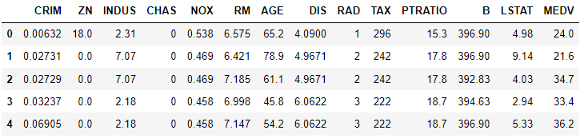
2. Loading the Dataset
df=pd.read_csv("Data (1).csv")
Df.head()
Dataset:

Slide 7
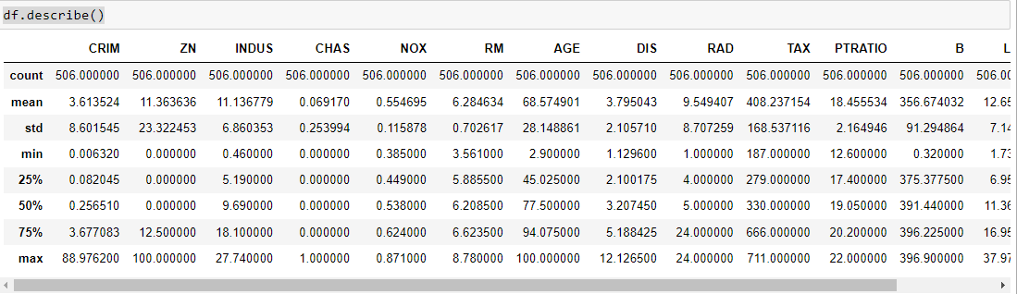
3. Perform Statistical information
df.describe()
Output:

Slide 8
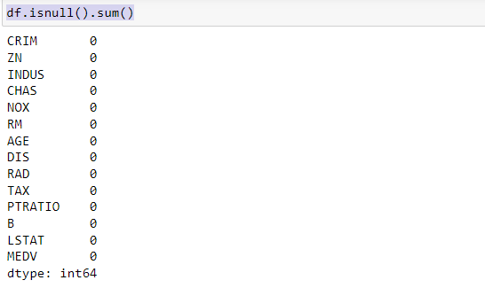
4. Preprocessing the Dataset
check for null values
df.isnull().sum()
Output:

Slide 9
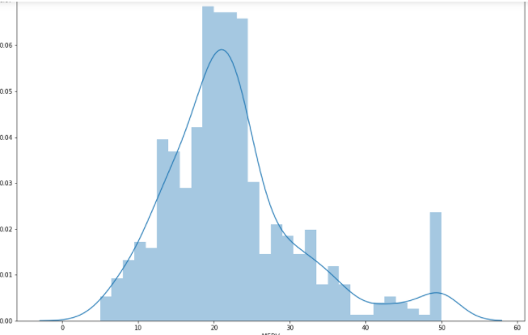
5. Perform Exploratory Data Analysis
Exploratory Data Analysis is a very important step before training the model. We will use some visualizations to understand the relationship of the target variable with other features. Let’s first plot the distribution of the target variable MEDV. We will use the distplot function from the seaborn library.
CODE :
plt.figure(figsize=(15,10))
sns.distplot(df['MEDV'], bins=30)
plt.show()

Slide 10
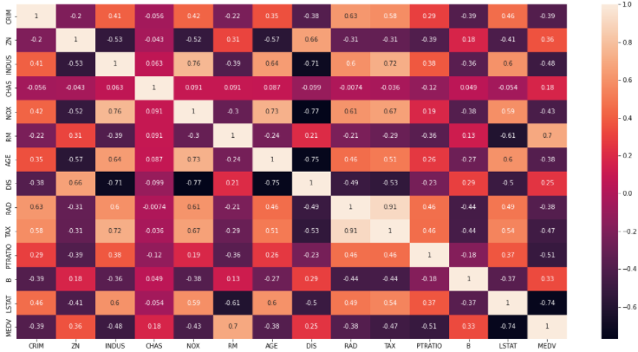
Continue…
Next, we create a correlation matrix that measures the linear relationships between the variables.
CODE:
plt.figure(figsize=(20,10))
sns.heatmap(df.corr(), annot=True)
plt.show()
Observation:
By looking at the correlation matrix we can see that RM has a strong positive correlation with MEDV (0.7) where as LSTAT has a high negative correlation with MEDV(-0.74).

Slide 11
6. Preparing the data for training the model
X= df.drop(columns=['MEDV'],axis=1)
y=df['MEDV']
7. Split the data into train and test data
from sklearn.model_selection import train_test_split
X_train, X_test, y_train, y_test = train_test_split(X,y,test_size=0.30, random_state=42)

Slide 12
8. Use ML Algorithm
/* Import Random Forest Regression */
from sklearn.ensemble import RandomForestRegressor
reg1 = RandomForestRegressor()
/* Train the model using the training sets */
reg1.fit(X_train, y_train)
print(f"Accuracy RandomForest Regressor :{reg1.score(X_test, y_test)}")

Slide 13


Predicted Result on Sample values
y_predict1=reg1.predict([[0.06905,0.0,2.18, 0, 0.458,7.147,54.2,6.0622, 3, 222, 18.7,396.90, 5.33]])
print(f"Result :{y_predict1}")
/*Actual value*/
df['MEDV'][4]
Output:
NOTE: The predicted price and actual price is almost same.

Slide 14
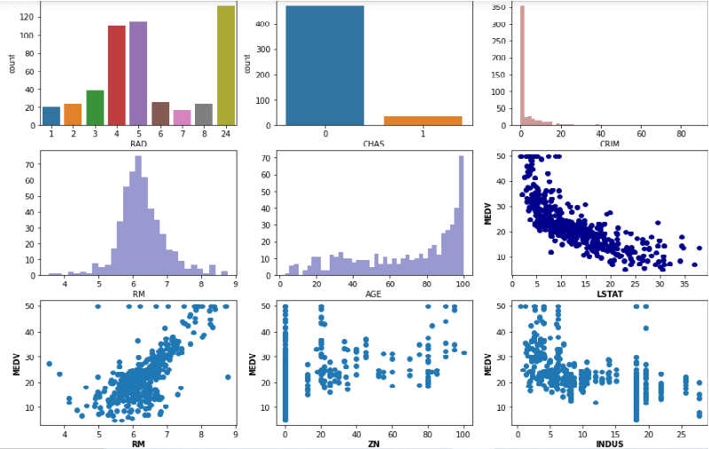
DASHBOARD:

Slide 15
THANK YOU !!!

